Slide 1

SOLDIER STRAP USING LORA MESH NETWORK
By
AKASHPRABU A C
ABIWAQAS Y
HEMANG MURUGAN
ASWINI K

Slide 2
OBJECTIVE
The soldier strap will be given to soldiers and it will have the following functionality,
GPS location of the soldier.
Will monitor and record maximum number of vital body parameters.
SoS facility.
Sufficient Battery Life.
Supports location timeline.
Transfers information by using a MANET-type communication system.
will access public network only when no node is available in immediate vicinity and only in case of emergency.

Slide 3
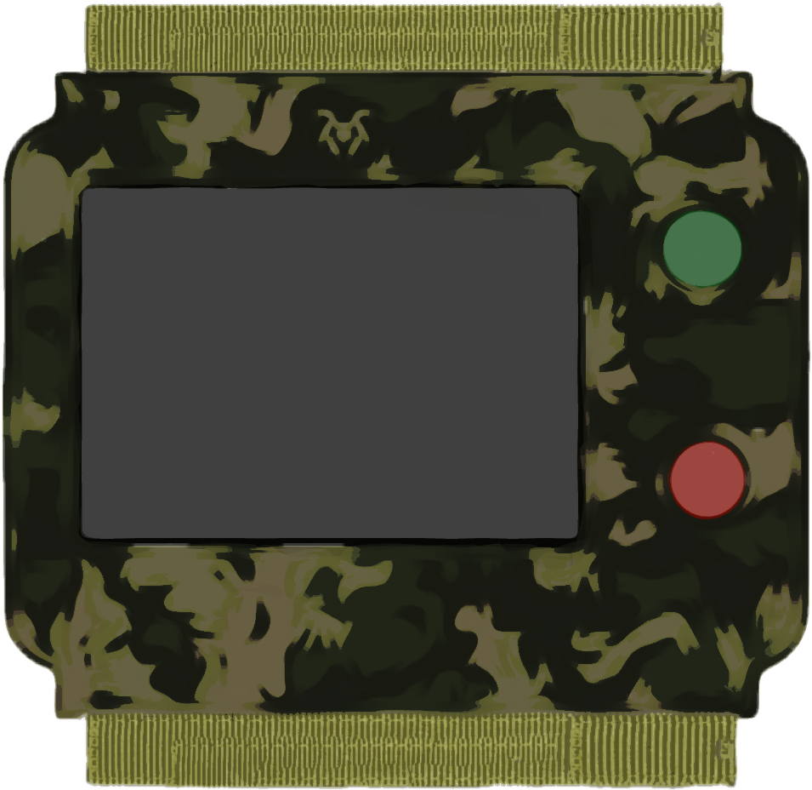
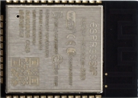
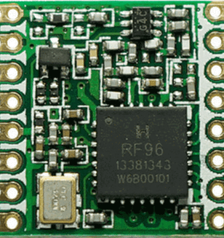
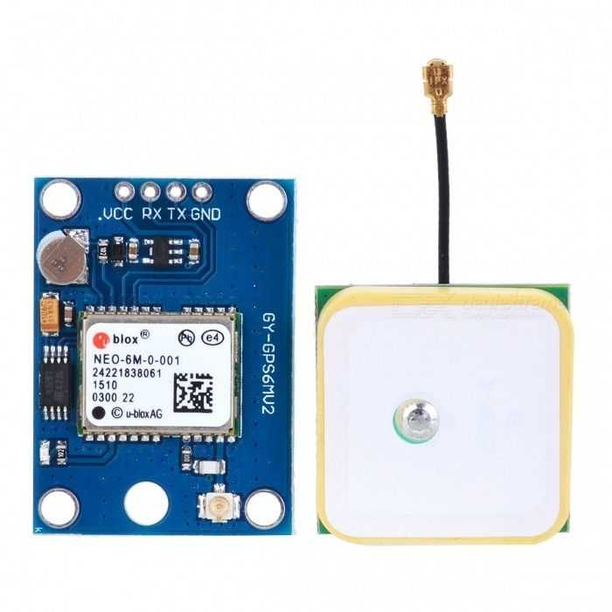
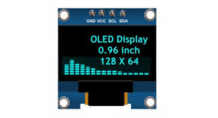
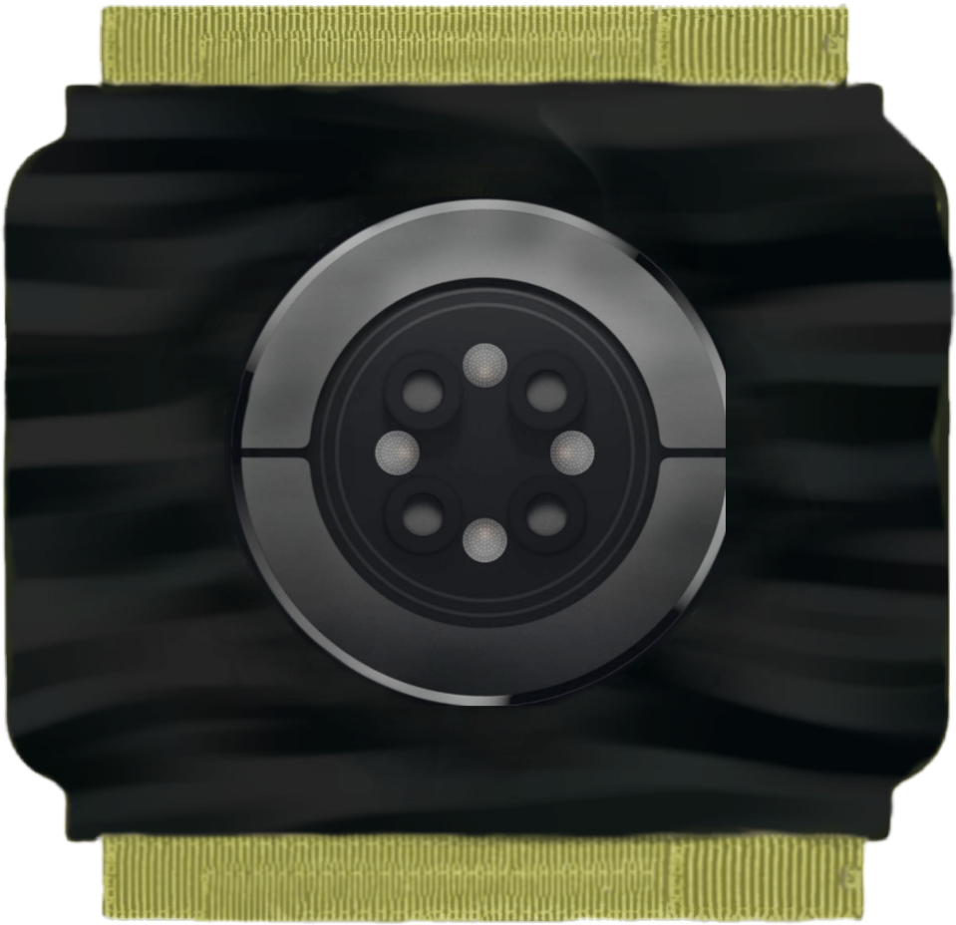
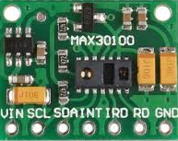
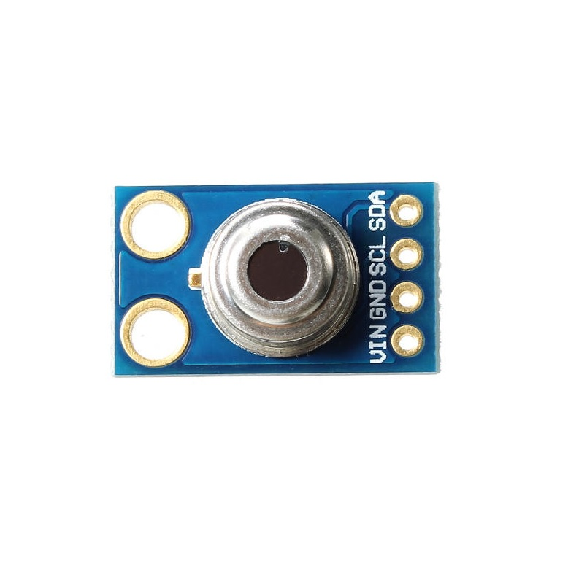
TECHNOLOGY STACK
FRONT VIEW
COMPONENTS
NATO Strap
Display ON/OFF
OLED display
SOS button
LoRa SX1278
ESP32 - WiFi Module
BACK VIEW
GPS
0.96 inch OLED display
Sensors for
monitoring
Body parameters
MAX 30100
PULSE OXIMETRY
& HEART RATE
mlx90614
Temperature sensor

Slide 4











USE CASE
Body
temperature
Heart rate
Oxygen level
Data Transmission to base station through MANET
When there is no MANET
Soldier with strap
GPS location
In case of EMERGENCY
When there is no LoRa
Connecting through LoRa module
Alert message broadcast to connected nodes and base station
SOS
Connects to public WiFi network

